Slide 1
Mixtape
_6

Slide 2
Warning:
You will NOT like my music (at all)

Slide 3


01.
Hummingbird
Has it brought my life back?
Hangin' in the balance
Have you brought the light back?
Pen pal on a night shift
She's who I get away with
Realising she might
Be all I need in this life
Metro Boomin, James Blake

Slide 4
02.
Calling
When I ran into ya, I didn't plan on fallin' in love
Always there to wipe your tears, I hate to see you cry
If you tell me to jump, I'll ask you, "How high?"
I know sometimes it be hard for me to tell the truth
But I go through any obstacle to get to you
I'm not materialistic, but I got a thing for you
Treat the world like my guitar, I'm pulling strings for you
Metro Boomin, Swae Lee, Nav, A Boogie Wit da Hoodie

Slide 5
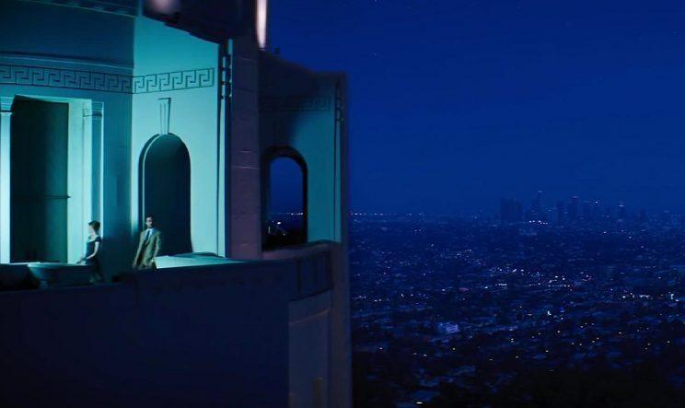
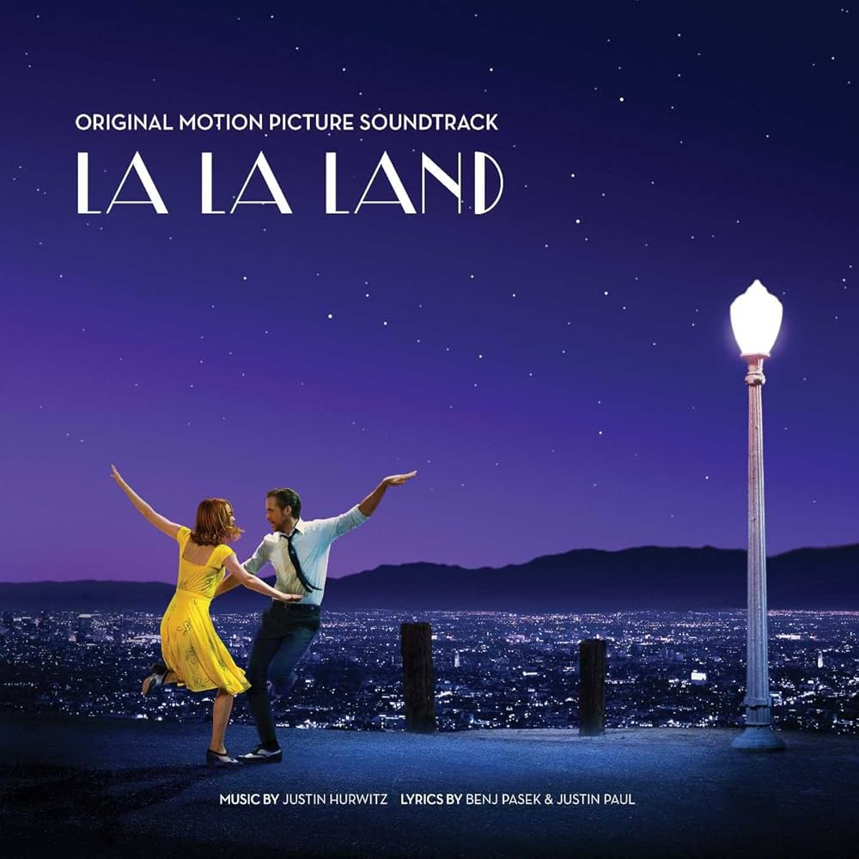
03.
A Lovely Night
We stumble on a view
That's tailor-made for two
What a shame those two are you and me
Some other girl and guy
Would love the swirling sky
But there's only you and I
And we've got no shot
This could never be
You're not the type for me
(Really?)
Ryan Gosling, Emma Stone

Slide 6
04.
Planetarium
_This one’s about the visuals :)
Justin Hurwitz

Slide 7
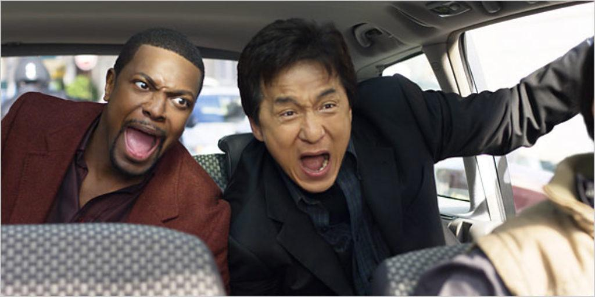
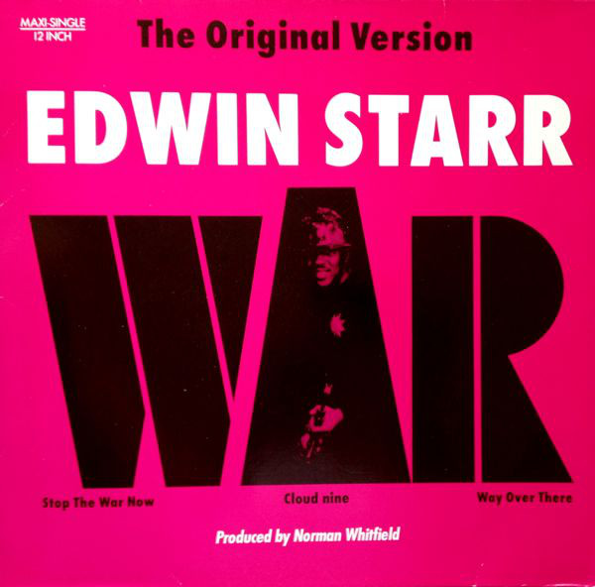
05.
War
🕺 💃🕺 💃🕺 💃
Edwin Starr

Slide 8
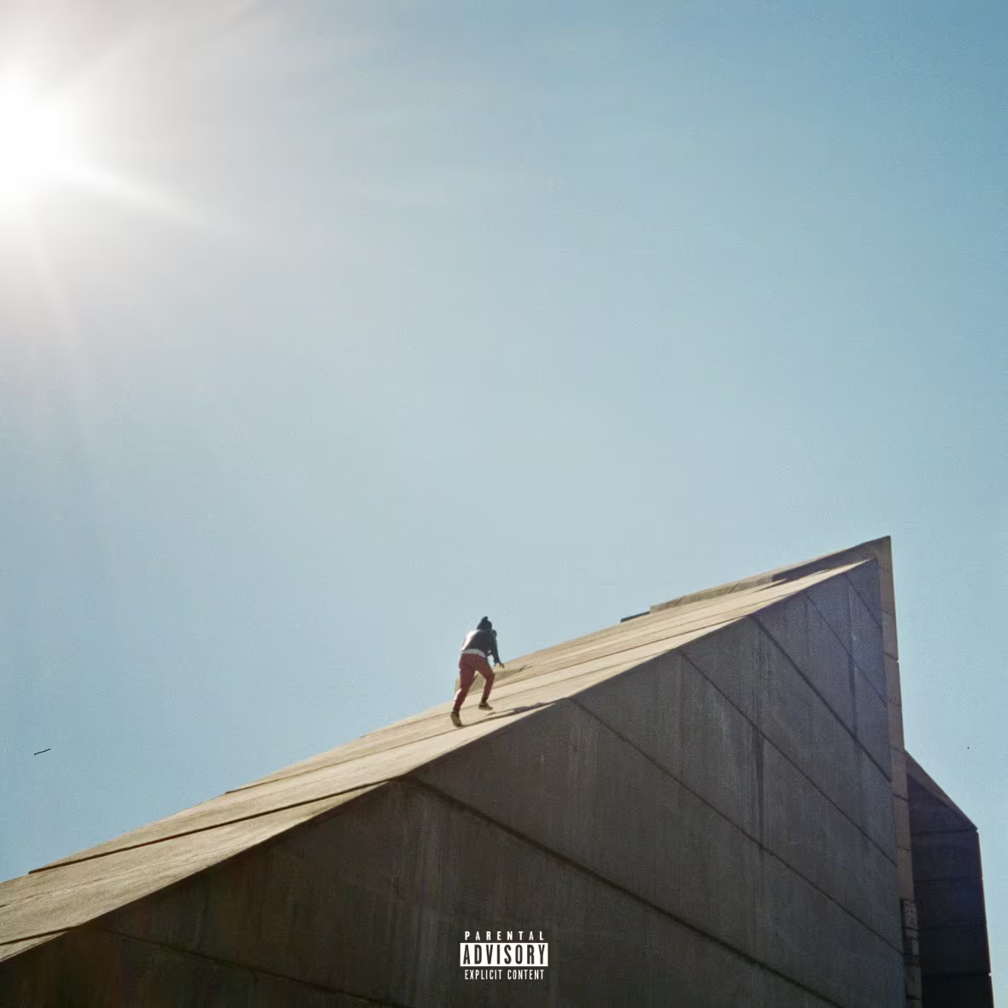
6.
Best Part
_Agreed, whole song
Daniel Caesar, H.E.R.

Slide 9
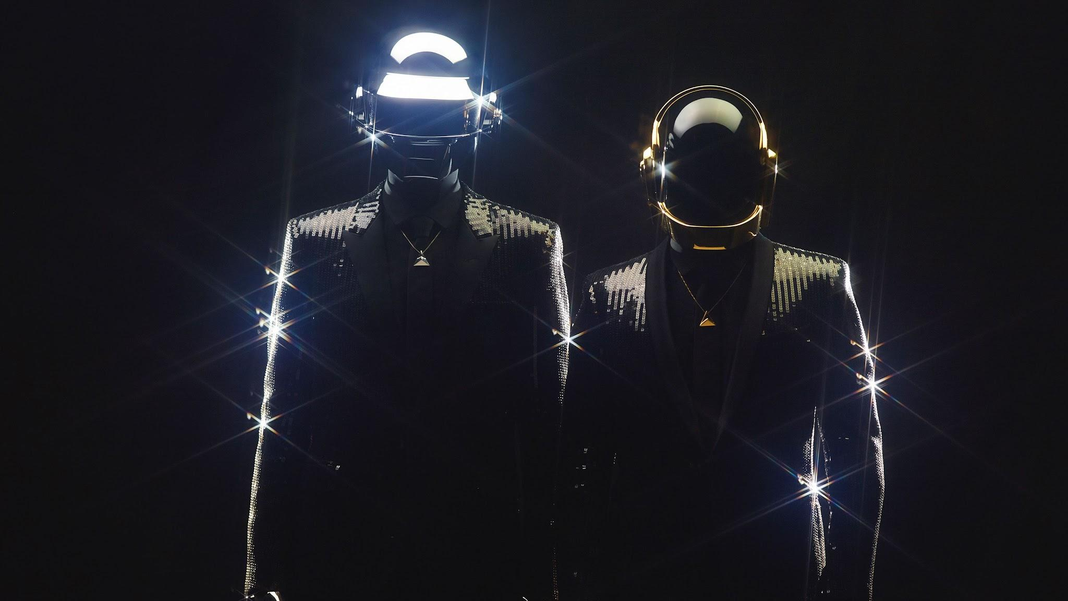

07.
Digital Love
Last night I had a dream about you
In this dream, I'm dancing right beside you
And it looked like everyone was having fun
The kind of feeling I've waited so long
Don't stop, come a little closer
As we jam, the rhythm gets stronger
There's nothing wrong with just a little, little fun
We were dancing all night long
The time is right to put my arms around you
You're feeling right, you wrap your arms around too
But suddenly I feel the shining sun
Before I knew it, this dream was all gone
Daft Punk

Slide 10
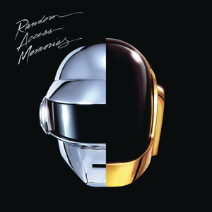
08.
Instant Crush
I thought of everything I'd never regret
A little time with you is all that I get
That's all we need because it's all we can take
One thing I never see the same when your 'round
Daft Punk, Julian Casablancas

Slide 11


09.
Mr. Brightside
_The song is about a girl who cheated on him, so it sounds weird to put here, but it's a good song and I like ONE line
Gotta, gotta be down because I want it all
It started out with a kiss, how did it end up like this?
It was only a kiss, it was only a kiss
The Killers

Slide 12
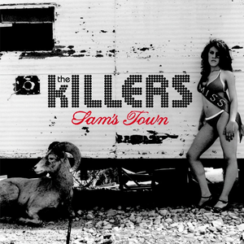
10.
When You Were Young
You sit there in your heartache
Waiting on some beautiful boy to
To save you from your old ways
You play forgiveness
Watch it now
Here he comes
He doesn't look a thing like Jesus
But he talks like a gentlemen
Like you imagined
When you were young
The Killers

Slide 13
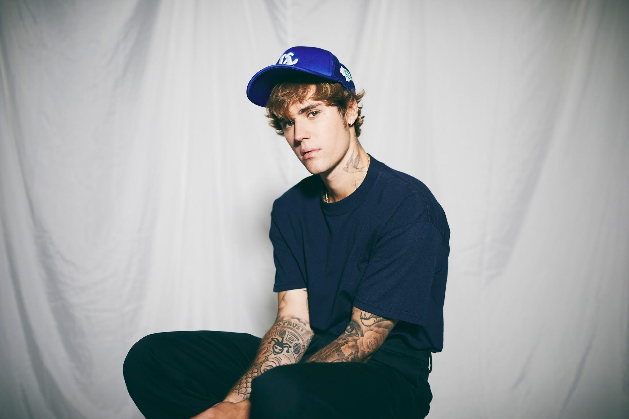

11.
2 Much
_Whole song
It’s so corny but it sums up everything PERFECTLY
Justin Bieber

Slide 14
12.
Deserve You
When I'm in my thoughts sometimes
It's hard to believe I'm the person you think I am
The person that you tell me you love
I'm on my ten thousandth life
Nine thousand nine hundred nine and it slipped my hands
But this one I'm not givin' up
Justin Bieber

Slide 15
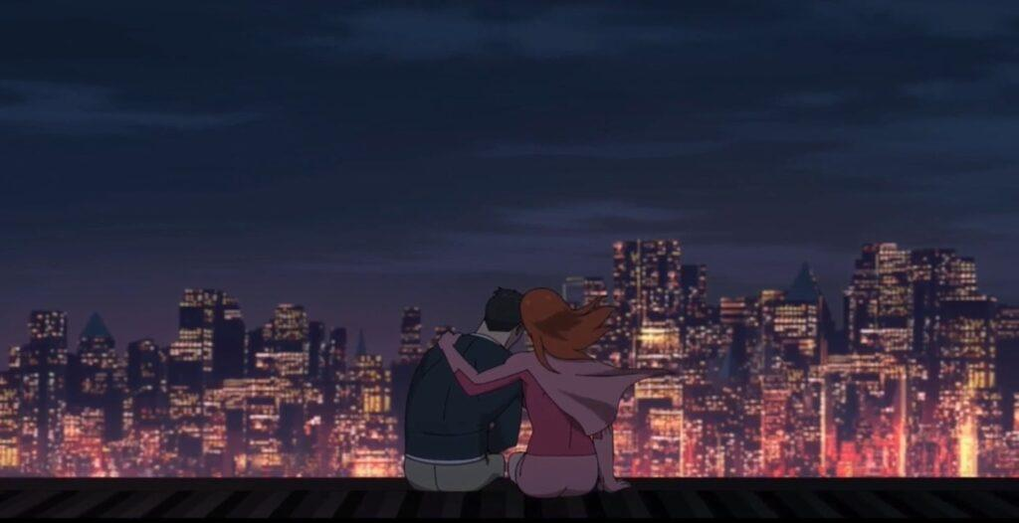

13.
Feel It
I'm ready to break down the door
Settle the score, I can't let you go away
I miss the smile off your face
You know that I lo-lo-lo-love the chase
You told me once that I was crazy
I said, "Baby girl, I know"
But I can't let you go away
So don't you get me started now
I want a yes, I don't want maybes
'Cause they leave me where you found me
So don't leave
D4VD

Slide 16
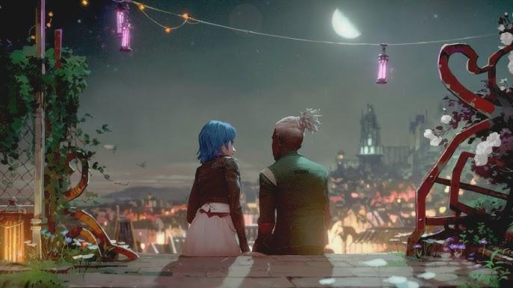

14.
Ma Meilleure Ennemie
_This one’s odd!
You're the best thing to ever happen to me
But also the worst thing to ever happen to me
On that day when I met you, maybe I would rather
That it never happened to me
The worst of all blessings
The best of all cursеs
I should stray away from you
But as the saying goes
"Bettеr than alone, is to be in bad company"
Stromae, Pomme

Slide 17
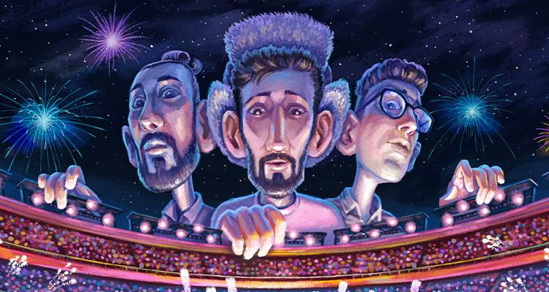

15.
Sober Up
Oh won’t you help me sober up
All the big kids they got drunk
And I wanna feel something again
(My favorite color is you)
AJR, Rivers Cuomo

Slide 18
16.
Weak
No, thank you
Is what I should have said
I should be in bed, but temptations
Of trouble on my tongue
Troubles yet to come
One sip, bad for me
One hit, bad for me
One kiss, bad for me
But I give in so easily
AJR

Slide 19
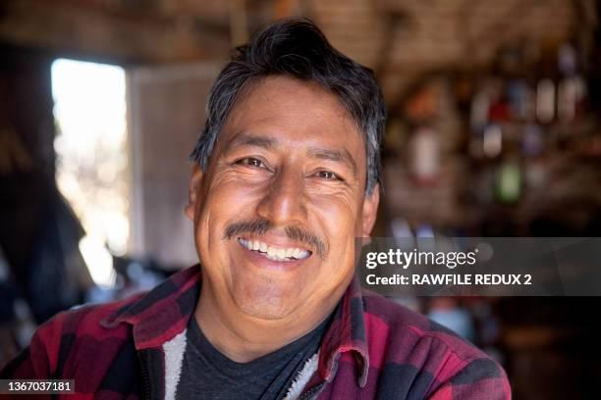

17.
Sure Thing
_Agreed, whole song
Miguel

Slide 20
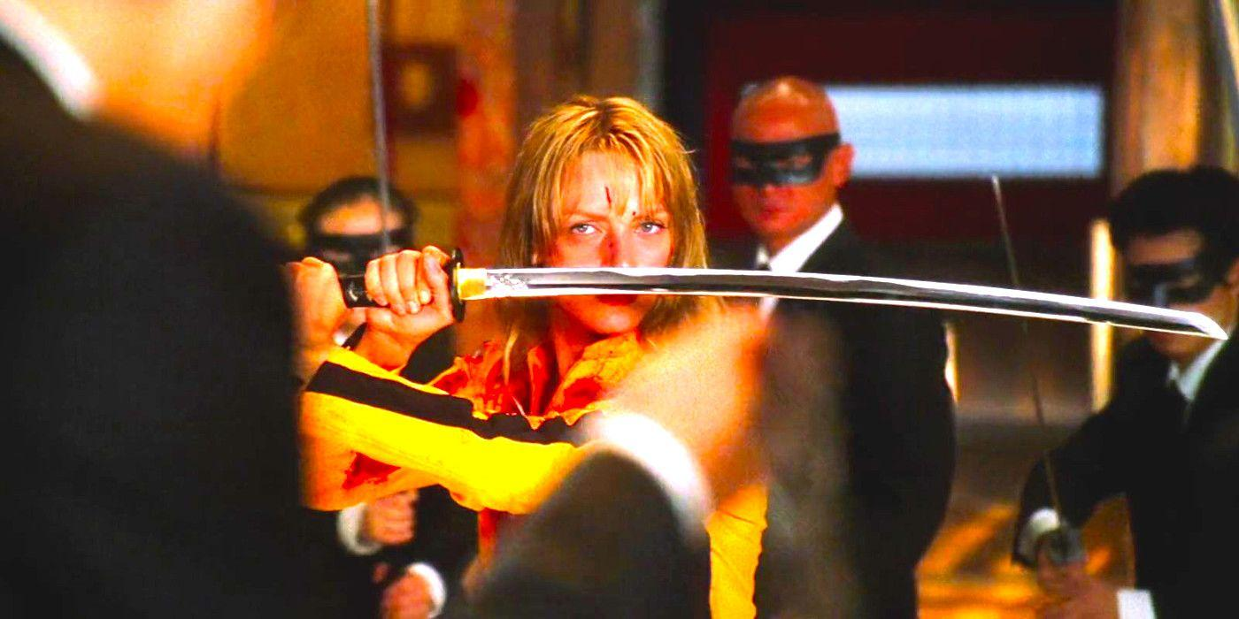
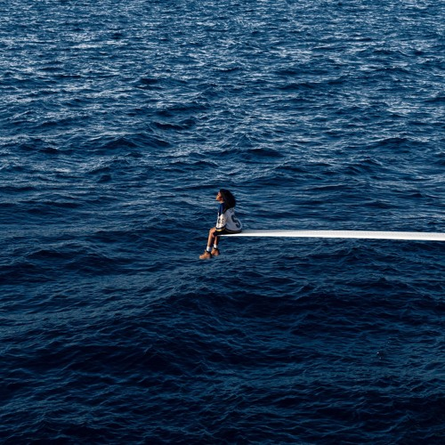
18.
Kill Bill
_First time I fell in love, and it was with your voice!
_We HAVE to watch the movies it’s so good
SZA

Slide 21
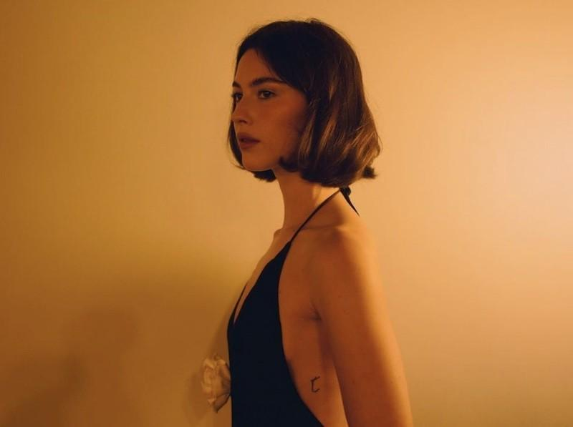

19.
That's So True
_I love when you think about my stupid dumb fucking face :)
Gracie Abrams

Slide 22
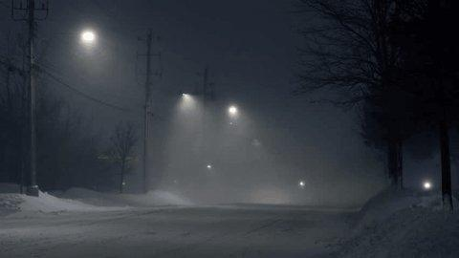
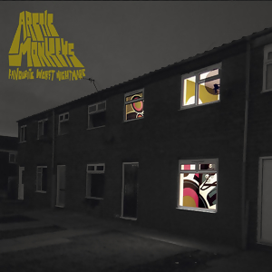
20.
505
I crumble completely when you cry
It seems like once again you’ve had to greet me with goodbye
Arctic Monkeys

Slide 23
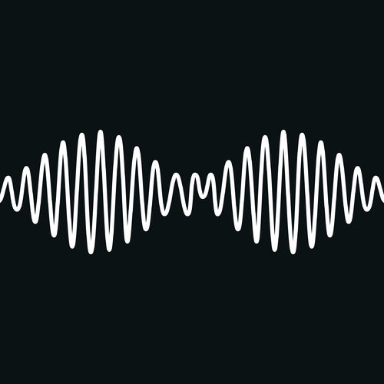
21.
I Wanna Be Yours
_And you are :)
_This song is so perfect
[The whole album is good]
Arctic Monkeys

Slide 24
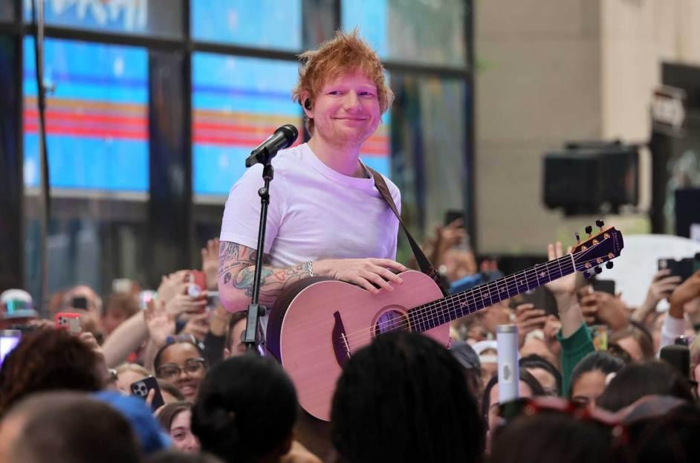
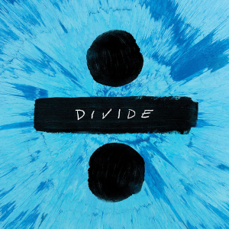
22.
Perfect
_Whole song
Ed Sheeran

Slide 25
23.
Supermarket Flowers
You were an angel in the shape of my mum
When I fell down, you'd be there holding me up
Spread your wings as you go
And when God takes you back
He'll say, "Hallelujah, you're home"
Ed Sheeran

Slide 26
24.
Dive
You're a mystery
I have traveled the world, there's no other girl like you
No one, what's your history?
Do you have a tendency to lead some people on?
'Cause I heard you do, mmh
I could fall or I could fly
Here in your aeroplane
And I could live, I could die
Hanging on the words you say
And I've been known to give my all
And lie awake, every day
Ed Sheeran

Slide 27
25.
Shape of You
Last night you were in my room
And now my bedsheets smell like you
_I hope I left my scent on urs :)
Ed Sheeran

Slide 28

26.
Thinking Out Loud
_Whole song
Ed Sheeran

Slide 29
27.
Photograph
We keep this love in a photograph
We make these memories for ourselves
Where our eyes are never closing
Hearts are never broken
And time's forever frozen still
So you can keep me
Inside the pocket of your ripped jeans
Holdin' me closer 'til our eyes meet
You won't ever be alone
Wait for me to come home
Ed Sheeran

Slide 30

28.
Shivers
Wrap me up between your legs and arms
Ooh, I can't get enough
You know you could tear me apart (ooh)
Put me back together, and take my heart
I never thought that I could love this hard
Ooh, I can't get enough
Ed Sheeran

Slide 31
29.
Overpass Graffiti
There are times when I can feel your ghost
Just when I'm almost letting you go
The cards were stacked against us both
I will always love you for what it's worth
We'll never fade like graffiti on the overpass
Ed Sheeran

Slide 32
30.
2step
We'll keep turnin' up, and go all night
Oh, we had dips and falls in our time
But we know what it feels to be low then up, alone then loved
And all we need is us to go all
Night
Ed Sheeran

Slide 33

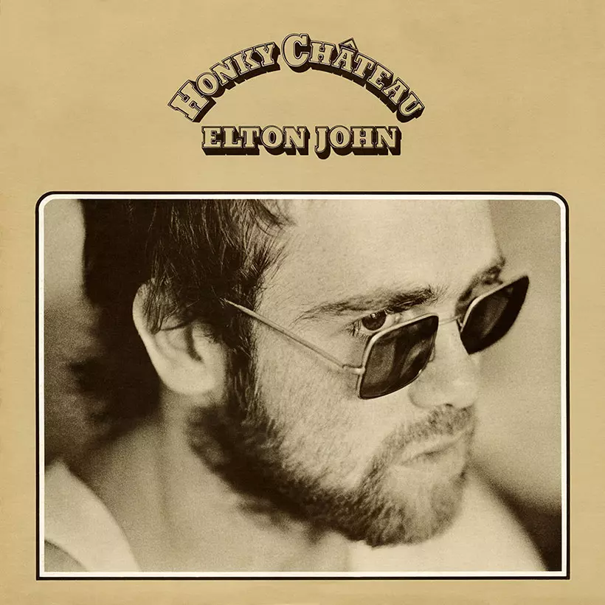
31.
Rocket Man
I miss the Earth so much, I miss my wife
It’s so lonely out in space
On such a timeless flight
_Too corny?
Elton John

Slide 34
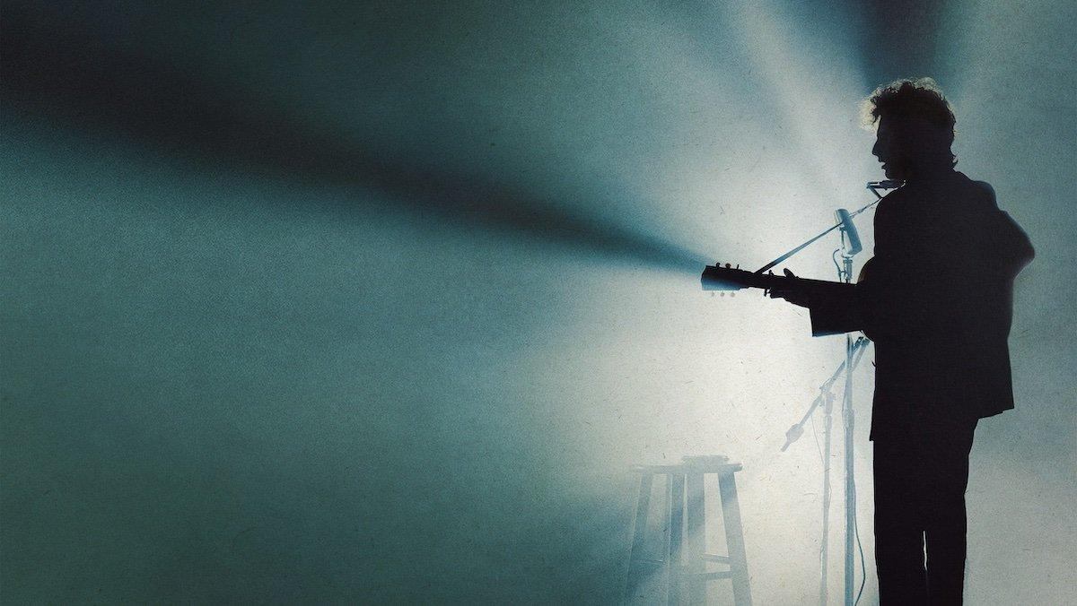
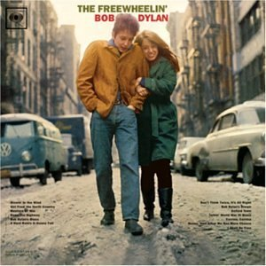
32.
It Ain't me
You say you're lookin' for someone
Who will promise never to part
Someone to close his eyes for you
Someone to close his heart
Someone who will die for you and more
_Ok he then says he’s not the guy for the girl I need to stop pulling songs from this guy this shit is not romantic at all
_His performance w/ Joan Baez is super romantic that’s why I chose it -_-
Bob Dylan, Joan Baez

Slide 35
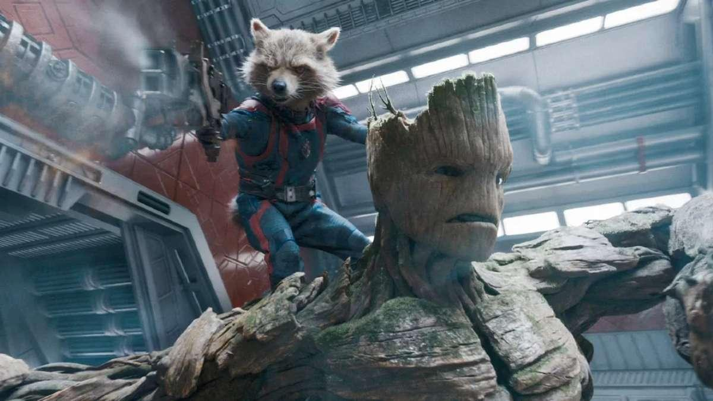
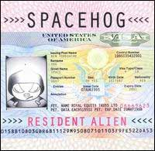
33.
In the Meantime
And when I cry for me, I cry for you
With tears of holy joy
For all the days, you've still to come
And did I ever say I'd never play
Or fly toward the sun
Maybe in the meantime something's gone
Spacehog

Slide 36
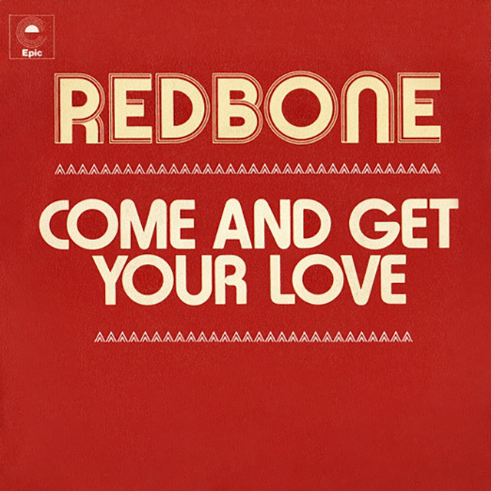
34.
Redbone
Come and get your love
Redbone

Slide 37
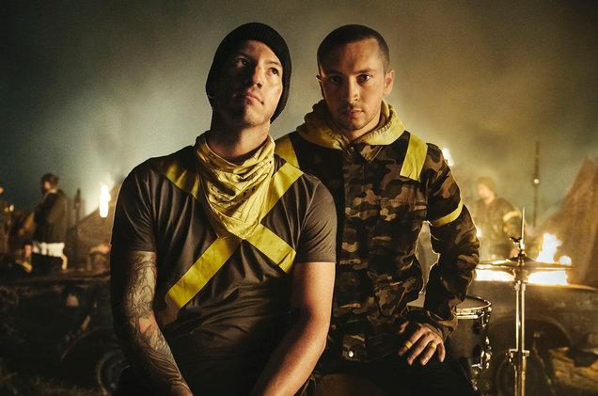
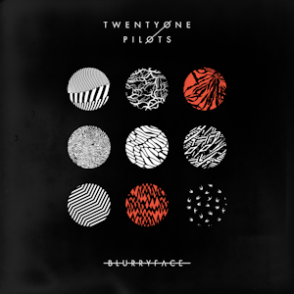
35.
Tear in My Heart
The songs on the radio are okay
But my taste in music is your face
And it takes a song to come around
To show you how
She's the tear in my heart
_Another emo sad breakup song?
Twenty One Pilots

Slide 38
36.
Stress Out
Used to play pretend, give each other different names
We would build a rocket ship, and then we'd fly it far away
_Reminds me of how lightheartedly we took everything in freshman year
Twenty One Pilots

Slide 39
37.
Ride
I’ve been thinking too much (help me)
I’ve been thinking too much (help me)
_Yikes corny alert
Twenty One Pilots

Slide 40

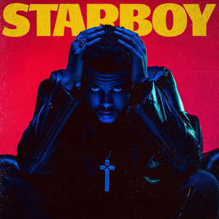
38.
Die for You
_Whole song
The Weeknd

Slide 41
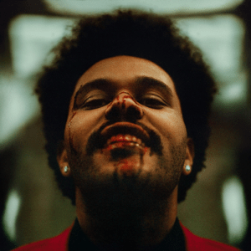
39.
Blinding Lights
I been on my own for long enough
Maybe you can show me how to love (maybe)
The Weeknd

Slide 42
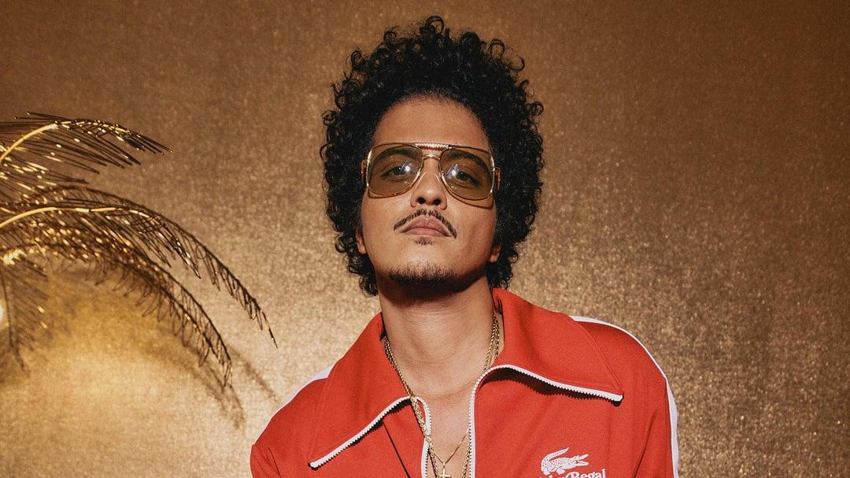

40.
Count on Me
If you ever find yourself stuck in the middle of the sea
I'll sail the world to find you
If you ever find yourself lost in the dark and you can't see
I'll be the light to guide you
Bruno Mars

Slide 43
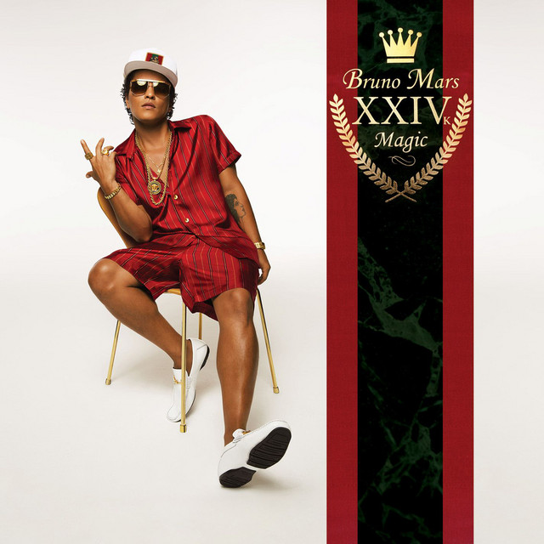
41.
That's What I Like
Anything you want, just to put a smile on it
You deserve it baby, you deserve it all
And I'm gonna give it to you
Bruno Mars

Slide 44
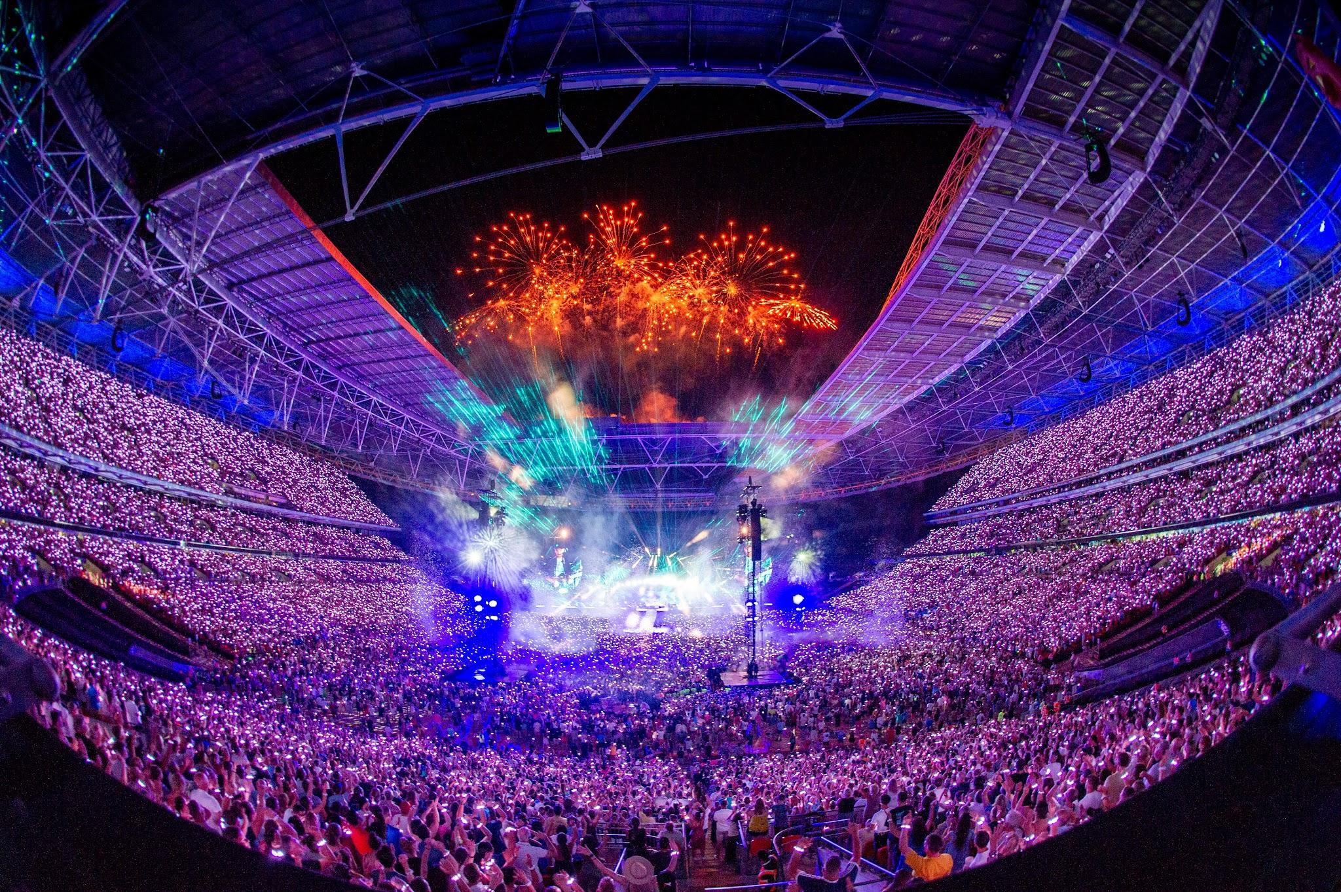
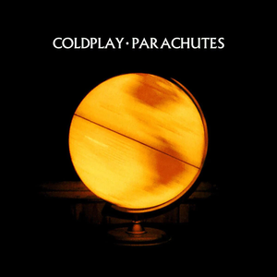
42.
Sparks
Did I drive you away?
I know what you'll say
You say, "Oh, sing one we know"
But I promise you this
I'll always look out for you
Yeah, that's what I'll do
Coldplay

Slide 45
43.
Yellow
Look at the stars
Look how they shine for you
And all the things that you do
Coldplay

Slide 46
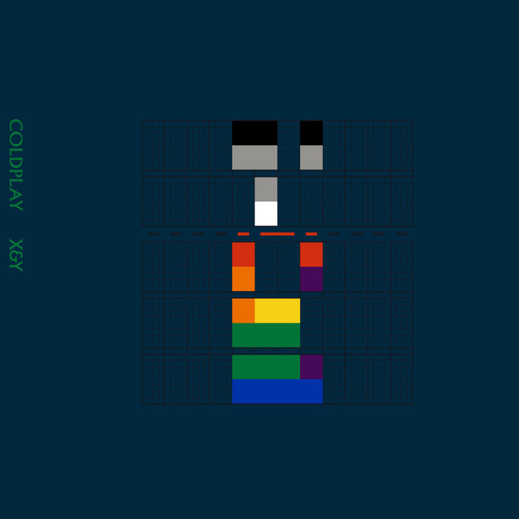
44.
Talk
So you don't know where you're going and you wanna talk
And you feel like you're going where you've been before
You tell anyone who'll listen, but you feel ignored
Nothing's really making any sense at all
Let's talk, let's talk
Coldplay

Slide 47

45.
Something Just Like This
_Whole song
Coldplay

Slide 48


Hi Aanya
I know you may not like all the songs here, but I couldn’t go without mentioning them because they all remind me of you. (for some reason)
It’s been rough but it’s also the best 6 months of my life so far, I love being a part of your world and I love that I can let you into mine. I love you :)

